Slide 1
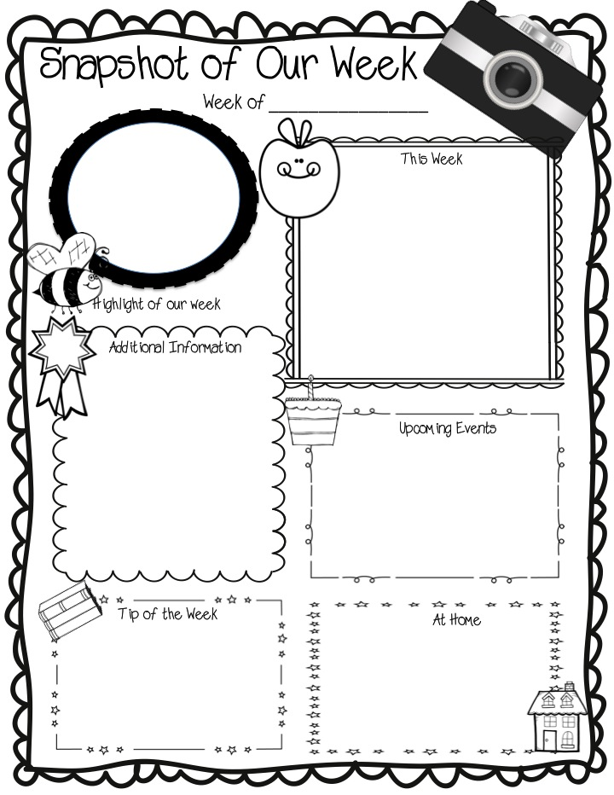
March 16 - 20, 2020
Cleveland City Schools At Home
Learning Experience
begins on Monday 3/23
Your teacher may be emailing or calling you to make sure you are able to use your login/password for I-Ready.
Please log into your child’s I-Ready using Class Link. You will need the username and password that has been sent to your earlier in the school year. Use Class Dojo to message your teacher if you need it.
*Go to the Cleveland
City Schools website for important information and links at www.clevelandschools.org
Your child’s teacher will monitor progress as the diagnostics for math & reading are completed.
Check Class Dojo Class Story and Dojo messages to contact your child’s teacher. Hours: 8:30-3:00

